Slide 1
Software product management
Assess opportunity
Joydeep Barman

Slide 2
Contents
Define value proposition
Assess value of the product
Business Plan
Story Map and Kano Model

Slide 3
Define value proposition
Steps:
Define Customer problem / pain point
  Ex. Difficult to reach Metro station (MetroRide)
Explain how your product solves customer problems or improves their situation (relevancy)
  Ex. Rent a bike – pickup near your house & drop anywhere (Bounce)
Determine a specific set of benefits it delivers, preferably quantifiable (Value)
  Ex. Easy to reach Metro station. Saves 30 minutes.
Explain why the customer should buy your product instead of the competition’s (Differentiation)
  Ex. More convenient than walking to bus stop, then taking a bus and then once again walk to the Metro station

Slide 4
Define value: Examples
Product | Pain point | How does it solve | Benefit / Value prop. | Differentiation from competition
MetroRide | Difficult to reach Metro station | Fixed route, shared auto | Easy to reach Metro station | More convenient than bus
AirBnB | Unable to get a feel for the city & its people & culture | Rent room in a house instead of hotel | Get unique experience of local culture | Hotels do not provide this experience
Zoom | Poor video quality | Better technology | Superior experience | Superior quality compared to WebEx

Slide 5
Assess value of the product
Talk to potential customers to assess the opportunity
  This is one of the most powerful and important skills for any product manager and very often the source or inspiration for many breakthrough product ideas.
Through interview, understand
  Are your customers who you think they are?
  Do they really have the problems you think they have?
  How does the customer solve this problem today?
  What would be required for them to switch?

Slide 6

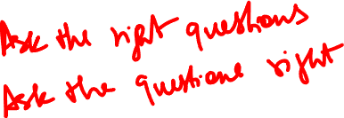
Interview customer: Example
‘Mom Test’: How to ask the right questions to assess a product idea?

Slide 7
Mom Test: Part 1
What wrong questions were asked?
Asking close ended question “You like your iPad right?” instead of “How often do you use the iPad?” or “What do you use your iPad for?”
Asking whether you will buy the product without first explaining the product: “”Would you ever buy an app which was like a cookbook for your iPad?”
Telling the features without first trying to understand what features are needed “you can share recipes with your friends, and there’s an iPhone app which is your shopping list. And videos of that celebrity chef you love”.

Slide 8
Mom test: Part 2
Did Mom have a need for recipe book on iPad?
Probably for healthy dishes
What market segments could be/ were discovered from the conversation?
Young people
What kind of recipe books could be targeted to young people?
    Basic dishes
What is good about this question: “What’s the last cookbook you did buy for yourself?”

Slide 9
Tips for customer interview
Go with intention to learn – Ask about their work, how they do it
Meet customer in their location – This will make them comfortable
Go with Product manager, UX designer and engineer – to brainstorm later
Do the customer's job for them, to understand the problem

Slide 10
Insight to be gathered during opportunity assessment:
Do consumers have the problem you are trying to solve? – Is our hypothesis true?
If there was a solution, would they buy it? – Is the need compelling?
Would they buy it from us? - Are we better than competition?

Slide 11
Also try to signup pilot customers, during this phase
Identify 6 customers who truly feel the pain and are near desperate for the solution we plan to build, who are willing to test the product and buy it once ready and willing to be referenced.
If you are unable to find even 4 or 5, then we are probably chasing a problem that is not very important.
It is important to explain that you are trying to build a product useful to many customers and not a custom solution.
Explain that you will dive deep into the problem and build a single solution that works well for all 6 customers.

Slide 12
Assess opportunity: Practice
Design a set of questions to validate the following product idea
Website to enable a company to identify the right software product to purchase for a given business need (B2B product)
  Pain point: There are many products in same category. Companies find it hard to pick a right product for their needs such as logistics, workflow, payroll, sales, customer service
  Solution:
    Provide a directory of selected software products along with product details, product comparisons, business use cases they support, etc.
    Provide phone consultancy to help clients select the right product for their need

Slide 13
Business Plan: Introduction
Once we have assessed an opportunity, it is good to put all our thoughts together on paper.
A detailed business plan covering – problem, solution. USP, market size, revenue generation, etc. needs to be created
A simple 1-pager plan can be created for quick understanding

Slide 14
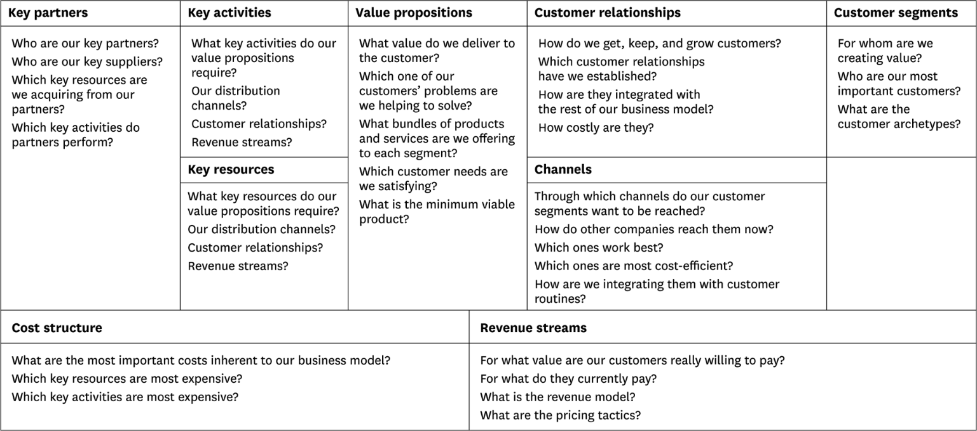
Business Model Canvas by Alexander Ostervald
Ref: www.businessmodelgeneration.com/canvas

Slide 15
Lean canvas – a simplified model
However, when in the early stage, it may not be necessary to go so much into detail, because our product is not yet ready, it has not been validated and many things will change which will yield the model redundant / waste.
Hence a simplified canvas called Lean Canvas is recommended at this early stage. This was proposed by Ash Maurya. Helps get your idea(s) out from your head into a tangible format so that you can communicate that with others

Slide 16
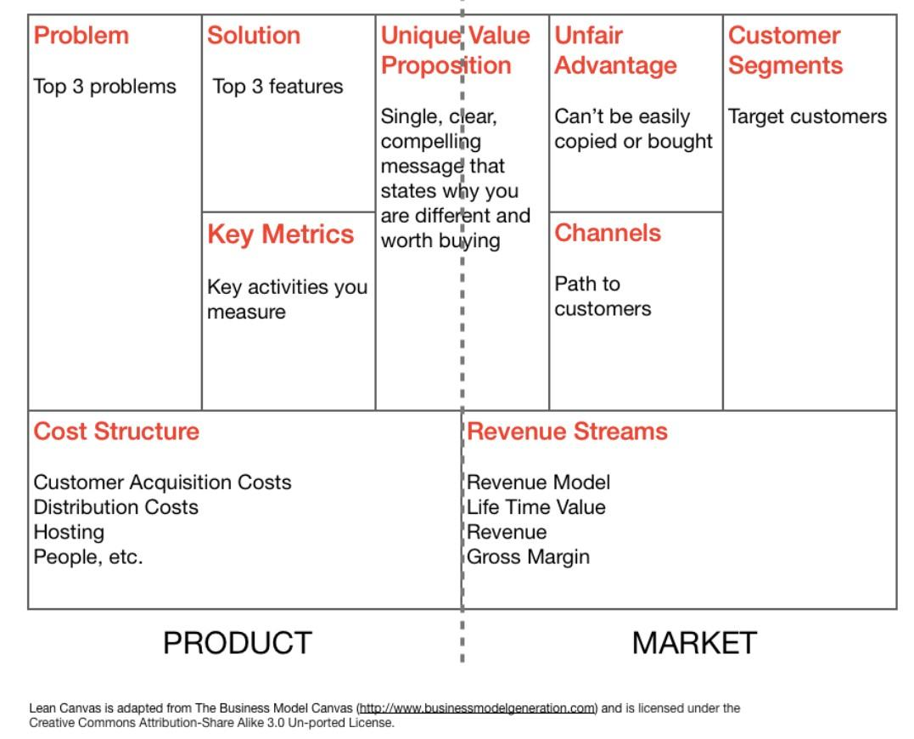
Lean canvas
Ref medium.com

Slide 17
Some explanations
Channels can be email, social, CPC ads, blogs, articles, trade shows, radio & TV, webinars etc.
Metrics can be how many visited, how many signed up, what is the usage, how many continued using
Unfair advantage can be insider information, a dream team, getting expert endorsements, existing customers etc

Slide 18
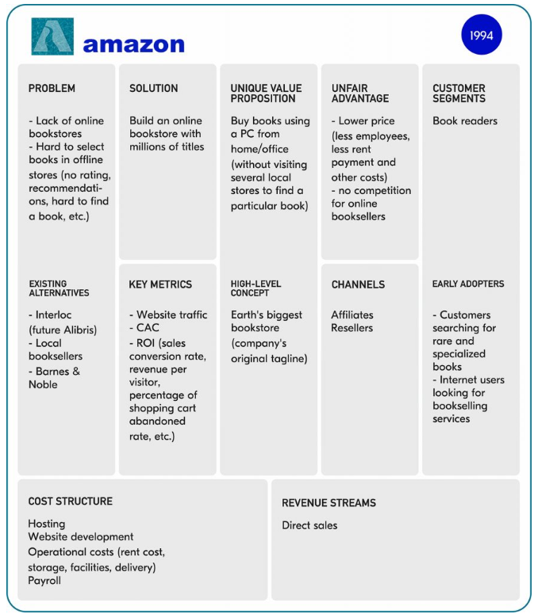

Slide 19
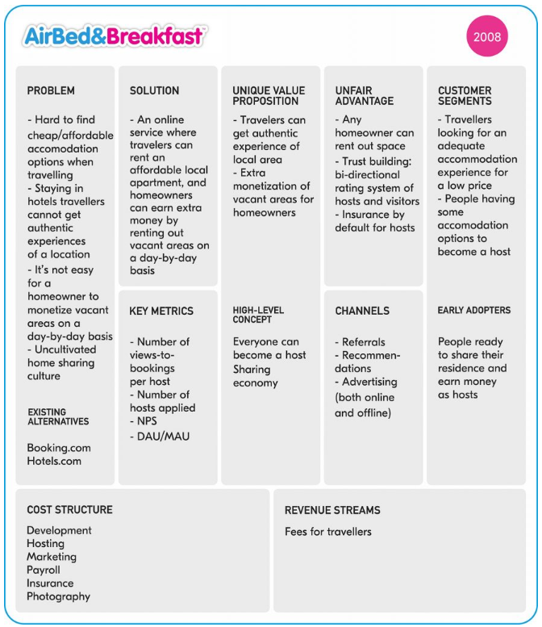
https://railsware.com/blog/5-lean-canvas-examples/

Slide 20
Story Map: Introduction
Once we have understood the need and we have assessed the need by interacting with customers & users, we need to capture all the requirements / features / functionality
Story map is an effective tool to capture the features
Invented by Jeff Patton

Slide 21
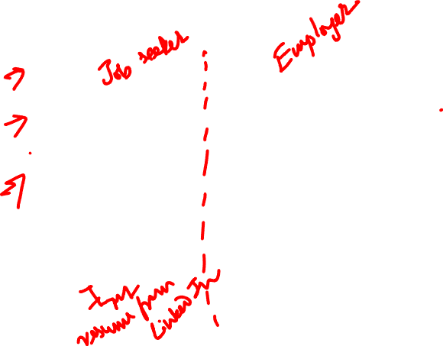
Story map: Job portal
Find job
Manage vacancy
Recruit candidate
User
Activities
(backbone)
Browse jobs
Post resume
Receive job alert
Post vacancy
Cancel vacancy
Search candidates
Contact
candidates
User
Tasks
(skeleton)
Search jobs (basic)
Upload resume - PDF
Subscribe for job alert
Submit job vacancy
Select job vacancy
See job applicants
Send message
Search jobs - location
Upload resume – MS Word
Receive SMS for newly posted jobs
Remove job vacancy
Read message (applicant)
User
stories
Build resume with resume builder
Receive SMS alert - last date approaching
Send interview request
Respond to interview request
https://www.visual-paradigm.com/guide/agile-software-development/what-is-user-story-mapping/

Slide 22

Story map: Job portal
Find job
Manage vacancy
Recruit candidate
User
activities
Browse jobs
Post resume
Receive job alert
Post vacancy
Cancel vacancy
Search candidates
Contact
candidates
User
tasks
Search jobs (basic)
Upload resume - PDF
Submit job vacancy
Select job vacancy
See job applicants
Send message
Release
1
Search jobs - location
Upload resume – MS Word
Remove job vacancy
Read message (applicant)
User
stories
Build resume with resume builder
Subscribe for job alert
Receive SMS alert - last date approaching
Send interview request
Release
2
Receive SMS for newly posted jobs
Respond to interview request
https://www.visual-paradigm.com/guide/agile-software-development/what-is-user-story-mapping/

Slide 23
About Story map
Story map
  Uses top down
  Helps organize features based on importance
  Helps plan releases

Slide 24
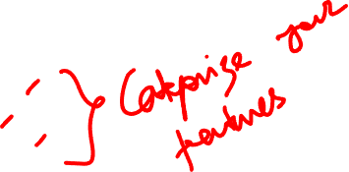
We need to classify and prioritize features: Kano model
Classification of product features:
Must have
Wants
Delighters

Slide 25
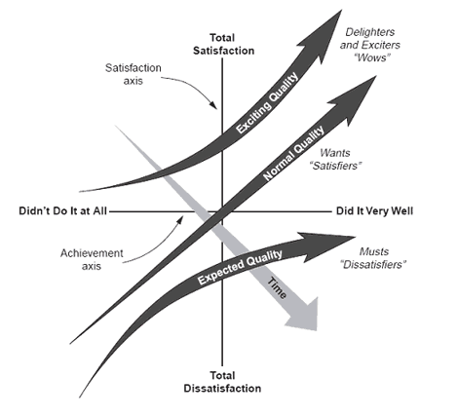
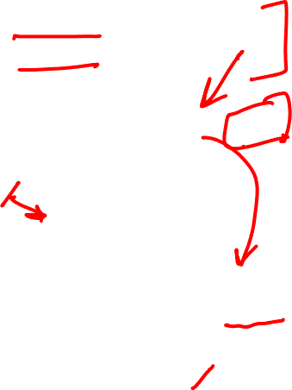
Classification of features changes over time…
As people start using the products, some features move on from Wants to Must haves and Delighters to Wants.

Slide 26
Exercise 4: Create your business model canvas
Key Partners: - Drivers with cars Lobbyists Payment processors Map API providers Investors | Key Activities: - Product development Marketing & customer acquisition Onboarding drivers Driver payouts Customer support | Value Proposition: Riders: Faster Cheaper Nicer Safer Drivers: - Flexible hours No training No upfront cost Reliable payment | Customer Relationship: Acquisition: - Country Launch team Direct promotions Support: Emergency button, phone, chat, email Review, rating & feedback system | Customer Segments: Riders: Do not own a car Want a ride to a party or function Want to travel in style Want a cheap & reliable ride Drivers: Own a car & want a ﬂexible source of income Own a car & love to drive
 | Key Resources: Platform & talent Drivers & riders Patents e.g. designs |  | Channels: Websites & 3rd party sites Mobile Apps (Android & iOS)
Cost Structure: Technological infrastructure Salaries to permanent employees Launch events & marketing expenditure |  | Revenue Streams: Car rides on per km/mile basis Surge pricing UberX, Uber Taxi, Uber Black, Uber SUV etc.

Slide 27
Exercise 4: Create your business model canvas
Key Partners: | Key Activities: | Value Proposition: | Customer Relationship: | Customer Segments:
 | Key Resources: |  | Channels:
Cost Structure: |  | Revenue Streams:

Slide 28
Exercise 4: Lean Canvas
(for new product or early-stage startup)
Problem: | Solution: | Unique Value Proposition: | Unfair Advantage: | Customer Segments:
 | Key Metrics: |  | Channels:
Cost Structure: |  | Revenue Streams:

Slide 29
Thank You!

